Slide 2
Unit 2: System Simulation (8 hrs)
2.1 Monte Carlo method
2.1.1 Problems regarding Monte Carlo method
2.2 Comparison of simulation and analytic solution
2.3 System simulation and its types
2.4 Real time simulation
2.5 Lag models (Distributed lag model, Cobweb model)
2.6 Queuing system and its characteristics and notation
2.7 Single server queuing model
2.7.1 Arrival routine
2.7.2 Departure routine
2.7.3 Performance measure of SSQM
2.8 Time advance mechanism (Next event oriented and fixed increment oriented)

Slide 3
Comparison of simulation and analytic solution
Feature | Simulation | Analytic Solution
Definition | Uses computer models and random sampling or step-by-step system imitation to predict behavior. | Uses mathematical formulas and equations to solve problems exactly.
Nature of Result | Approximate (results vary slightly each time; probabilistic). | Exact (one precise answer, deterministic).
When Used | When the system is too complex to solve analytically, or when randomness needs to be modeled. | When the system is simple enough or mathematically well-defined for direct solution.
Speed | Can be slow, especially for complex or large systems. | Generally faster once the solution formula is derived.
Handling Complexity | Good for very complex systems with multiple variables and randomness (e.g., traffic flow, queuing, weather prediction). | Hard for very complex or random systems (can become unsolvable).

Slide 4
Comparison of simulation and analytic solution
Feature | Simulation | Analytic Solution
Randomness | Can easily handle random events, uncertainty, probability distributions. | Purely deterministic; can't handle randomness unless modeled mathematically.
Flexibility | Very flexible — changes can be incorporated easily into the model. | Less flexible — changing assumptions may require rebuilding the mathematical model.
Interpretation | Requires statistical interpretation (confidence intervals, error margins). | Straightforward interpretation — direct answer.
Example | - Monte Carlo simulation to predict stock market returns. - Simulating patient flow in a hospital. | - Solving F=maF = maF=ma for acceleration. - Finding roots of a quadratic equation using a formula.

Slide 5
Experimental Nature of Simulation
Simulation is an experimental problem-solving technique.
Many simulation runs have to be made to understand the relationships involved in the system.
Therefore, the use of simulation in a study must be planned as a series of experiments.

Slide 6
System Simulation
System simulation means creating a virtual model of a real-world system and experimenting with it to predict or study its behavior over time.
Instead of working with the real system (which can be risky, expensive, or impractical), we simulate it using computer programs or mathematical models.
Goal: Understand, improve, design, or optimize the real-world system by observing the simulation results.
Examples:
Simulating a hospital's patient flow to reduce wait times.
Simulating a car factory's assembly line to find bottlenecks.
Simulating weather patterns for forecasting.

Slide 7
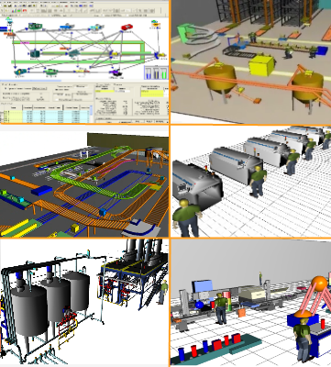
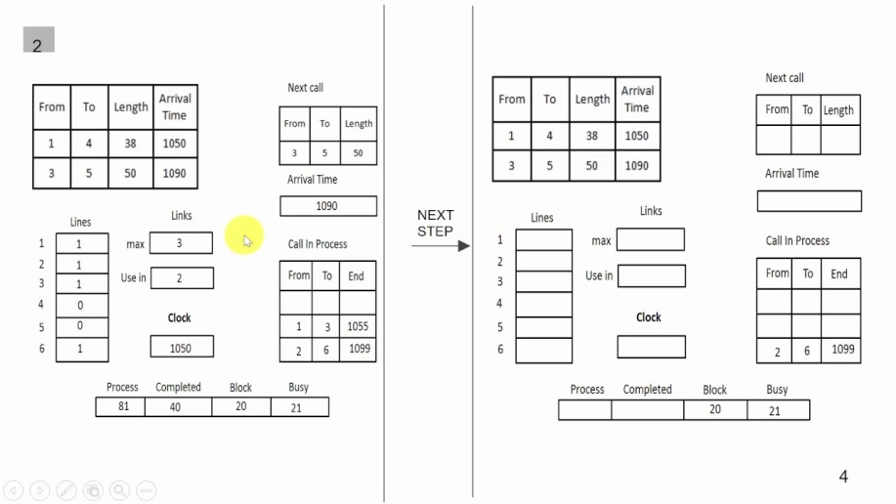
System Simulation
There are two kinds of system simulation, and they are:
Continuous System Simulation
Discrete System Simulation

Slide 8
Discrete System Simulation
System changes at specific points in time (events).
Between events, nothing happens.
Events trigger system changes (like customer arrival, machine breakdown).
Example:
A bank where customers arrive at random times and wait in a queue.
Airport check-in counters.
Tools: Arena, Simul8, AnyLogic (DES mode)

Slide 9
Continuous System Simulation
The system changes continuously over time, not just at specific events.
Usually modeled by differential equations.
Example:
Simulating water flowing through a pipe.
Population growth over time.
Tools: MATLAB Simulink, System Dynamics models.

Slide 10
System Simulation Types
1. Live Simulation
Involves real people operating real systems or subsystems.
Tests performance, coordination, or procedures in a real-time environment.
Real-world conditions; often used in military, fire drills, emergency response training.
Example:
Fire drill in a hospital
Military field exercise with real vehicles and personnel
Police practicing a riot control scenario

Slide 11
System Simulation Types
2. Virtual Simulation
Real people use simulated equipment in a virtual environment.
Provides immersive, hands-on training without real-world consequences or costs.
Uses VR/AR, simulators, and human-machine interfaces.
Example:
Flight simulator used to train pilots
Virtual driving tests
Surgery simulations for medical students using VR headsets

Slide 12
System Simulation Types
3. Constructive Simulation
Simulated people operate simulated systems in a model.
Used to study complex systems, strategize, test decisions, or perform what-if analysis.
No real participants; everything is modeled and computed.
Example:
Battlefield simulation software running scenarios to test military strategy
Monte Carlo simulations for stock market modeling
Traffic flow simulation in a city using software agents

Slide 13
Real-time Simulation
Real-time simulation is when a computer simulation runs at the same speed as the real-world system it is modeling.
It updates results instantly as inputs or events happen, just like reality.
The simulation clock matches the real clock (1 second simulated = 1 second real time).
Objectives:
To mimic real-world behavior instantly so users can interact, monitor, or control the system as if it were real.
Often used for training, testing, or control system development.

Slide 14
Real-time Simulation
Field → Real-Time Simulation Example
Flight training → Pilot simulators that respond instantly to control movements.
Vehicle testing → Car engine simulators that test how a car behaves under different road conditions without a real car.
Medical training → Surgery simulators where doctors practice operations.
Gaming → Racing games where car movement responds instantly to user control.
Robotics → Robot arm simulations that react in real time to programming or sensor data.

Slide 15
End of Lecture 5

Slide 16
Lag Models

